Slide 1

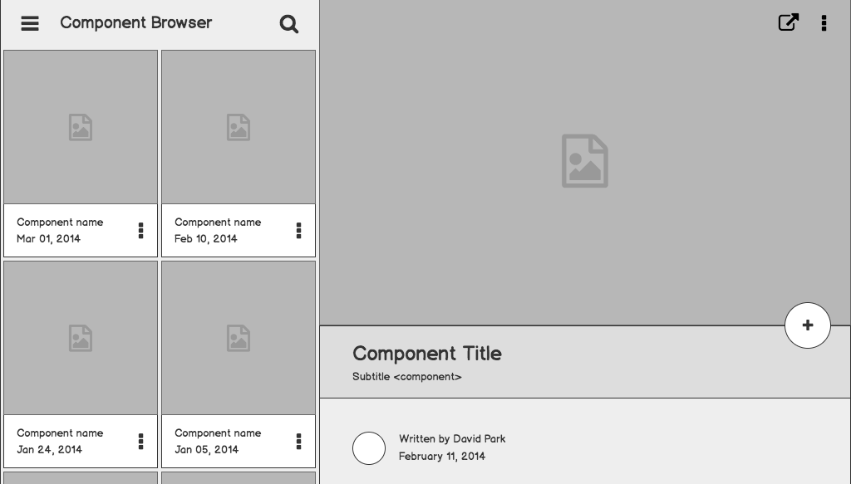

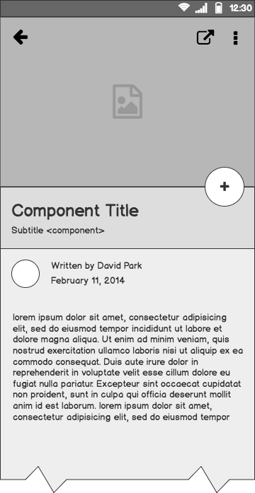
Doctors On Demand
Software Architecture & Design
DoD is being developed to allow patients to talk to a Doctor whenever, regardless of whether you have medical insurance coverage or not. Online Medical Care 24/7 is the future for treating patients.

Slide 2
Outline
The Problem
Solution Proposal
Designs
Technical Details
Final Thoughts

Slide 3
The Problem
The concept for the Doctors On Demand App came about from patients who expressed other alternatives to Urgent Care facilities, Emergency Rooms and Hospital appointments for minor concerns and questions.

Slide 4
Problem statement
The Doctors on Demand App has been developed by a team who wanted to make an impact on the medical industry as we know it. The DoD App goal is to reach anyone who does not want to wait days to visit a doctor or must book an in-person appointment just to speak with their primary care physician. The focus for now is on the national level with the intent to expand internationally in the future. So, come and sign up and enjoy a new fresh idea to modern medicine as we know it.

Slide 5
What customers do today
Doctors and patients today must call and / or log into hospital portals to schedule appointments. If there is a dire situation a patient typically goes to the Emergency Room or calls an Ambulance for immediate medical attention.

Slide 6



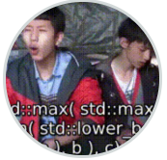
Supporting information
03
Ayana Perry
Jinal Bangur
Product Team Manager/Developer
Requirements Engineer/Tester
Product Manager & backend and API development.
Requirements Analyst/UX Designer/Tester
Reference your personas, if you have them.
Development Manager
UI Developer Lead
Oversees all product development & UI.
UI development and design engineer

Slide 7
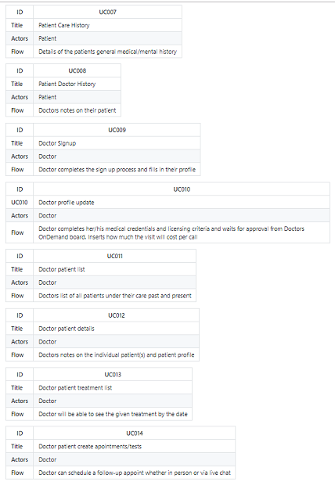
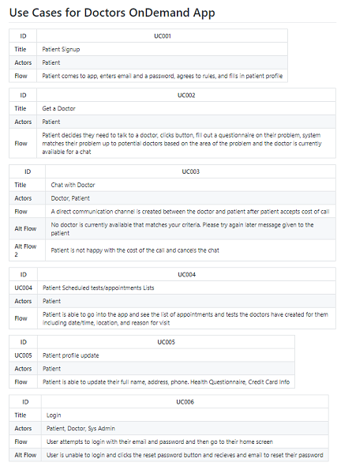
Use cases

Slide 8
Designs
Information Diagram
Actor Screen flows
Screen Mocks (TBD)

Slide 9
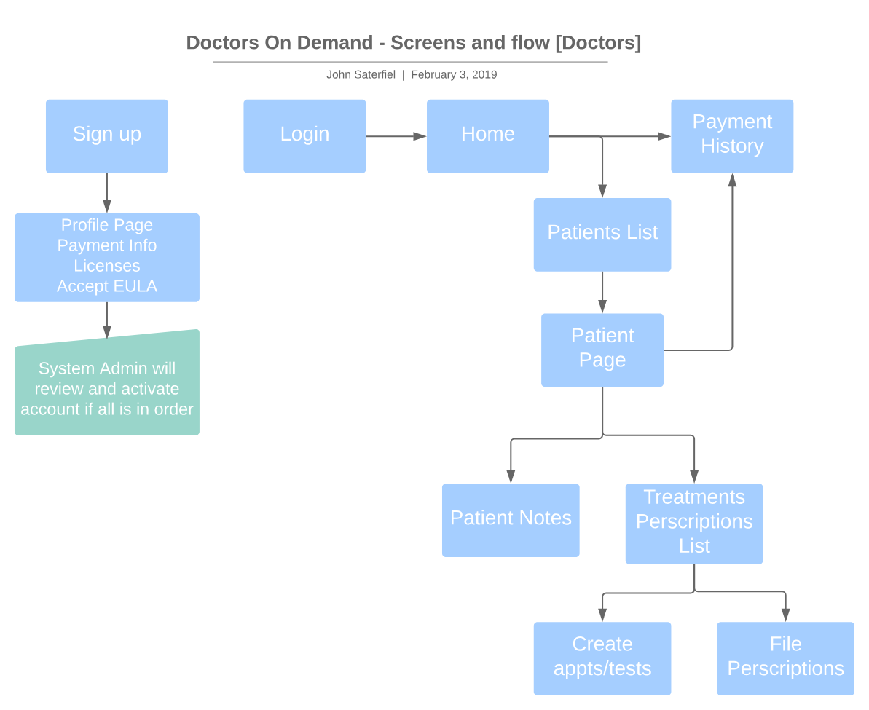
Screenflow - Doctors

Slide 10
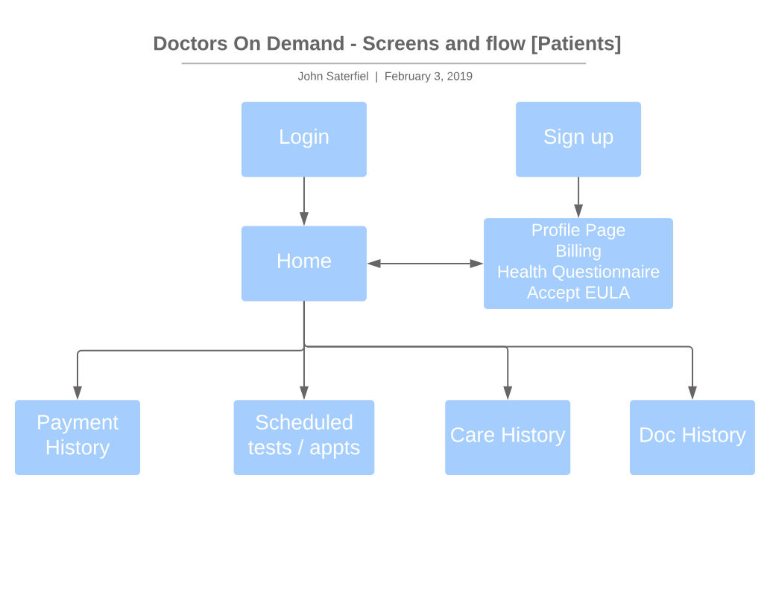
Screenflow - Patients

Slide 11
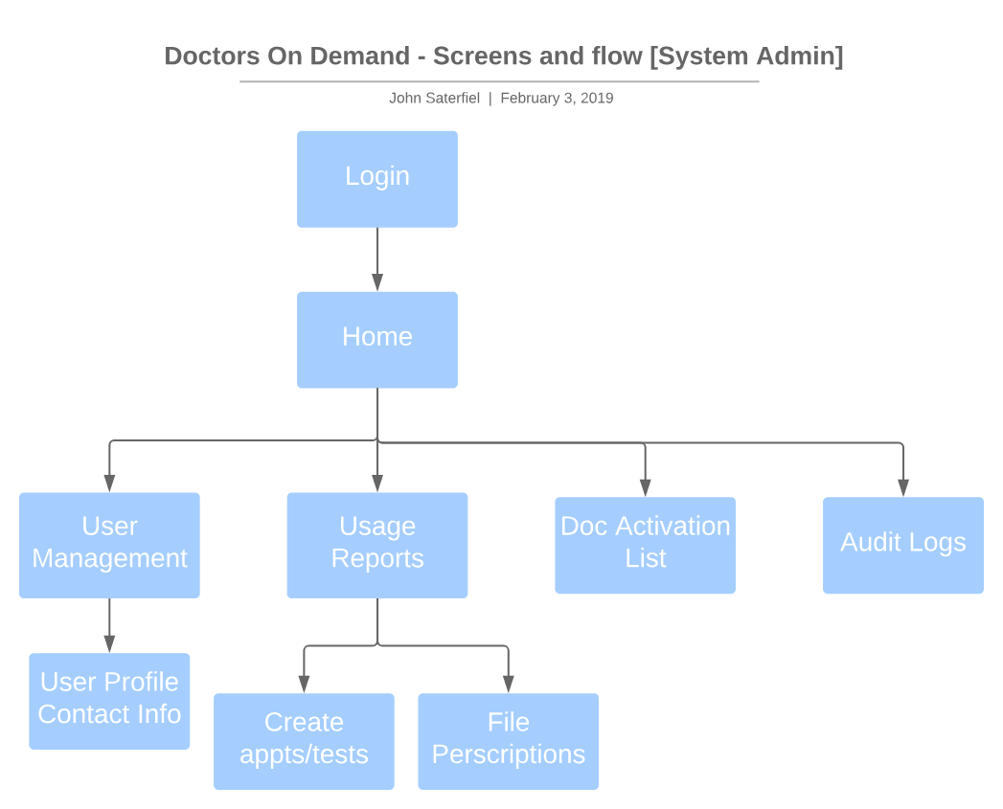
Screenflow - System Admin

Slide 12
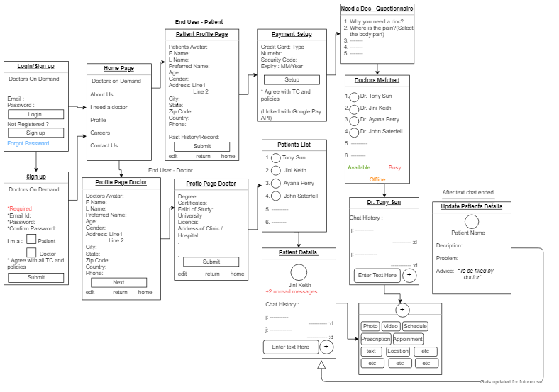
Information Diagram

Slide 13
Technical Details
System Architecture
Logical views for doctors and patients
Software Details
Environments
Security Concerns

Slide 14
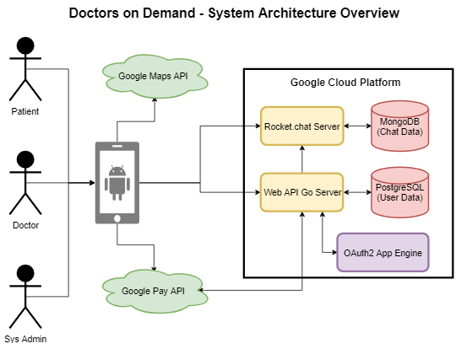
System Architecture

Slide 15
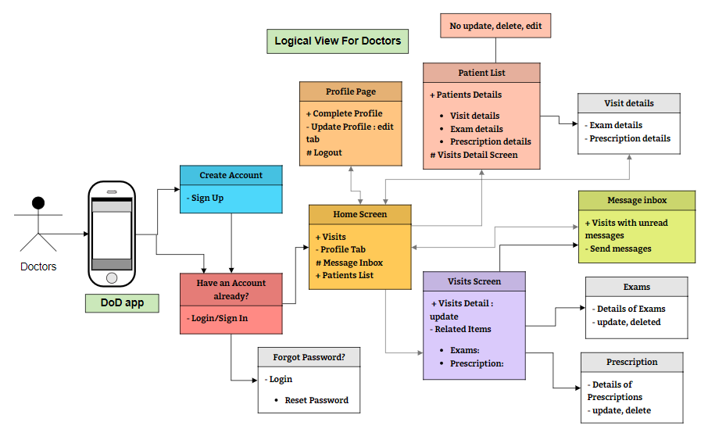
Logical View for Doctors

Slide 16
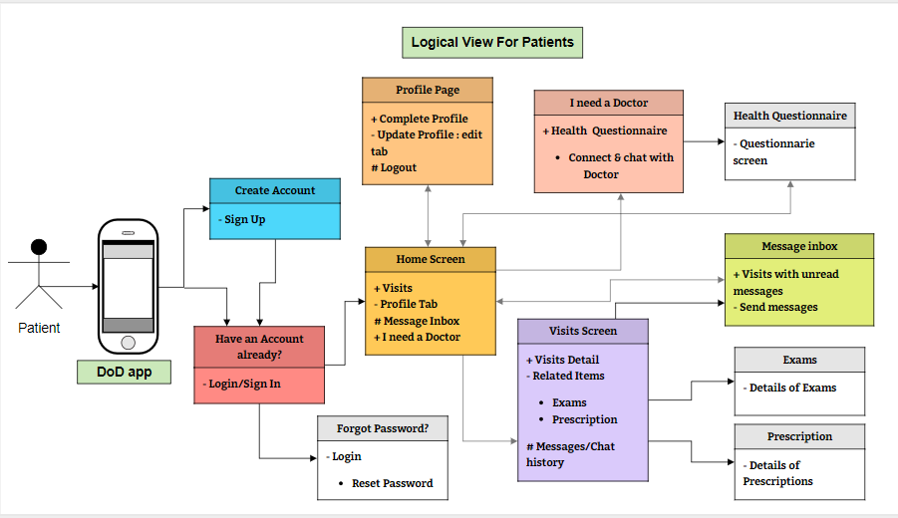
Logical view for patients

Slide 17
Software Details
Google Flutter for App Development
Android OS 9.x
Google Cloud Platform for hosting
Travis for CI/CD tasks
Draw.io & Moqups for diagrams/wireframes
Ubuntu Linux for hosting
Containerize (later)
MySQL 5.7 Database (managed)
Go Lang 1.11.x Web Services
Whatsapp for team communication
Chat messages using api calls
Visual Studio Code for Web Service API work
Android Studio for App Development
Golang unit testing for Web Services
Investigate Flutter Unit Testing
Google OAuth for securing api
Google Pay API for payments
Google Maps API in app

Slide 18
Environments
Development Web Stack
Used for development team only. Can be broken for up to 24 hours. Connected to development branch
UAT Web Stack
Used for presentations and demos for clients to present each milestone.

Slide 19
Security Considerations
TLS
Added to ensure secure connections between the web servers and app
Passwords
Enforced passwords complexity https://github.com/nbutton23/zxcvbn-go
Session IDs
Use session ids to ensure user ids are not passed around and that requests cannot be manually manipulated to get data from other users
User Roles
Users will have roles for permission levels and will be enforced in the Web Service

Slide 20
Mobile Application Wireframes:
Login and DoD Details
Signup UI
Home Screen and Visit Screen
Visit Detail and Related Items screen
Exam and Exam Detail Screens
Prescription and its Detail screens
Profile and Chat Screens

Slide 21
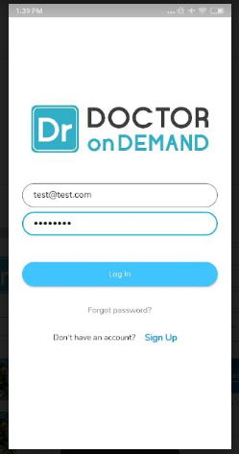
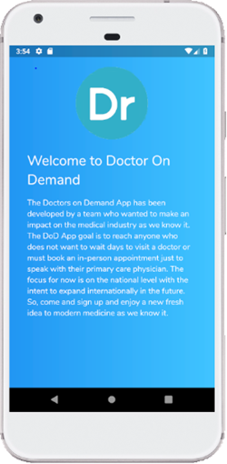
Login and DoD Details

Slide 22
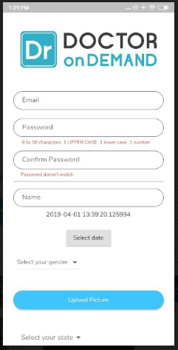
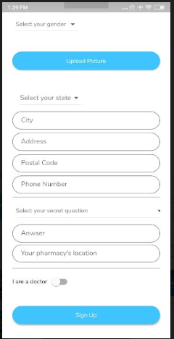
Signup UI

Slide 23
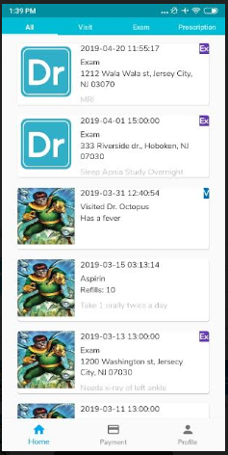
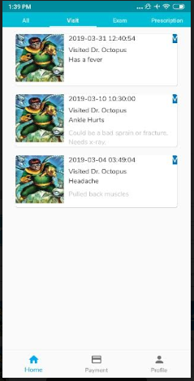
Home Screen and Visit Screen

Slide 24
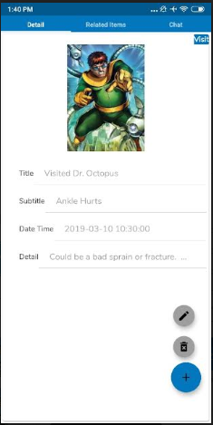
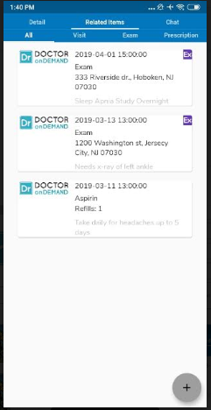
Visit Detail and Related Items screen

Slide 25
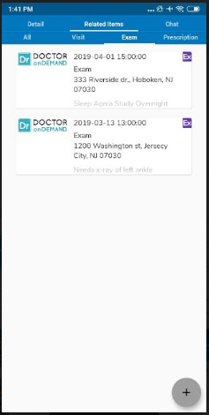
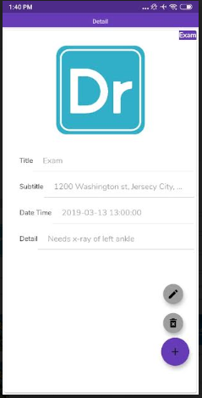
Exam and Exam Detail Screens

Slide 26
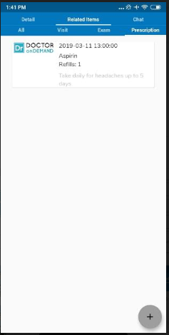
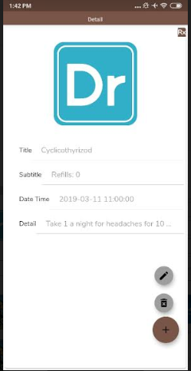
Prescription and its Detail screens

Slide 27
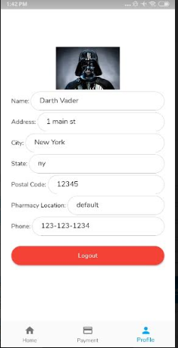
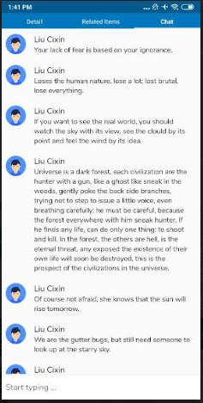
Profile and Chat Screens

Slide 28
Team Processes
Revision Control System
Branching Strategy
Sprint Flow
Reviews
Change Process
Team Meetings
Definition of Done

Slide 29
Revision Control System
Github repo: https://github.com/aperry567/SSW690B
Travis CI for CI/CD only running against Development branch
CI/CD builds kicked off by merges to Development branch
Pull Requests require 2 approvers

Slide 30
Branching Strategy
Master Branch
UAT code, ready for demo
No direct commits
Only branch into directly for quick bug fixes
Developer Branch
Issues completed, merged and tested
No direct commits
Pull requests will go into this branch from your branches
Issue Branches
Issues being worked
Named after ticket with short title
Critical Bug issues
Can be a branch that has a pull request to master also requires 2 approved

Slide 31
Sprint Flow
Single Project in Github
Kanban board used for tracking in progress issues
Github issue created for each user story
Short clear title aka Summary
Short description in the “As a <role> I want to do <action>” format
Assigned to person working on them
T-Shirt sizing through labels (foregoing story points as github doesn’t have them)
small, medium, large
Additional Labels for components:
App, API, DB, CI/CD, Infra
Additional Labels for type
Bug, Feature
Github Milestones for milestones
Clear acceptance criteria which must be used for unit tests
Team grooms issues after Sprint Meetings
Sprints planned at Status Meetings
Pull Requests required for all changes
End of sprint review completed issues and demo more important issue per person

Slide 32
Reviews
All changes require a Pull Request
Must have 2 people to approve a Pull Request
Peer programming for some of the backend APIs
Pull Request must have:
Clear title from issue
Description with link to issue
Milestone of the issue
Project of the issue
Assigned Reviewers (two not coding the issue)
A reviewer must manually test the code
Unit Tests that cover the acceptance criteria must be in the Pull Request
Unit tests that check negative test cases must be in the Pull Request

Slide 33
Change Process
Issue created with details for change and links to any affected issues
Brought up to team via whatsapp or as part of a scheduled meeting
Team will review change and decide as a group if this seems reasonable
Guidelines for making a change:
Avoid scope creep unless needed to fulfill existing Use Cases
Reduces scope while maintaining Use Cases
Current solution not feasible
Got finished early and want to add extra features

Slide 34
Team Meetings
General Communications
Whatsapp for team communication
Sprint Meetings
Fridays at 7:30pm
Google Hangouts for meeting when not in person.
Status Meetings
Within typical class meeting time
Issue Branches
Schedule a meeting remotely at a convenient time
Google Hangouts for the meeting

Slide 35
Definition of Done
Definition of Done
All coding is completed
Pull Request reviewed and approved by 2 people
Code Manually tested by 1 person
All automated unit tests passing to be able to merge a Pull Request

Slide 36
Final Thoughts
What’s Next?
Project Timeline
Questions

Slide 37
What next?
Next week we will create user stories for sprint 4 and plan out any final features.
The requirements engineer will complete work on the User testing plan
Research and implement the payment processing
Add automated testing for APIs
Add automated integration testing
Add automated testing for front-end

Slide 38
Project Timeline
FEB
FEB
MAR
MAR
MAR
APR
Requirements gathering
Wireframes Prototypes Infrastructure
Milestone 1 Able to login to App
Milestone 2 Chat System Patient Screens
Milestone 3 Doctor Screens
Milestone 4 Dev Complete System Admin Screens

Slide 39
Questions?

